Slide 1
Cricket Shots Analysis using AI
Team Members
Bhuwan Khatiwada (18208)
Bishwa Prakash Subedi (18209)
Niraj Duwal (18226)
Rewan Gautam (18230)
Under the Supervision of
Associate Prof. Suramya Sharma Dahal
Department of Electronics and Computer Engineering
Institute of Engineering, Thapathali Campus
March 9, 2022

Slide 2
Presentation Outline
Motivation
Introduction
Problem Statement and Objectives
Project Scope
Project Applications
Methodology
Results
Results Analysis
Future Enhancements
Conclusion
References

Slide 3
Motivation
Aware of need of insights to improve one's game
Use of technology can help analyze players better

Slide 4
Introduction
An AI based project related to field of cricket
An application to classify the shots played and calculate their efficiency

Slide 5
Problem Statement and Objectives
Problem Statement:
Manual classification of shots
Unable to keep accurate history of player's progress
Unavailability of statistical data for players
Cannot generate accurate result using simple algorithms

Slide 6
Problem Statement and Objectives Cont..
Objectives:
To classify the shot played by the batter using machine learning model into six categories (Cover Drive, Straight Drive, Scoop, Cut, Pull, Leg Glance)
To make a profile for each player displaying frequent and least shots played
To determine how well the batter played the shot in three classes (Missed, Edged, Perfect)

Slide 7
Project Scope
In cricket academies
For broadcasters
For professional teams

Slide 8
Project Applications
For academies to analyze and train players
For broadcasters to provide statistical analysis
For professional teams to plan match strategies

Slide 9
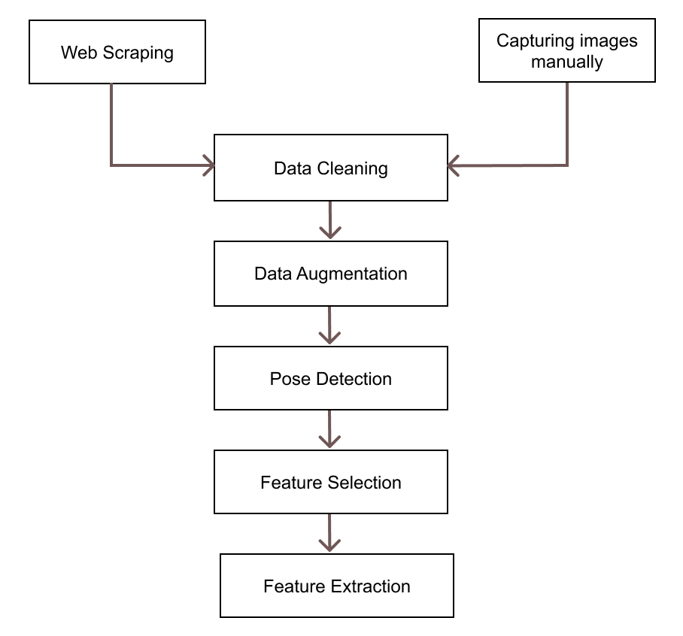
Methodology
Fig: Data Collection and Feature Extraction Block Diagram

Slide 10
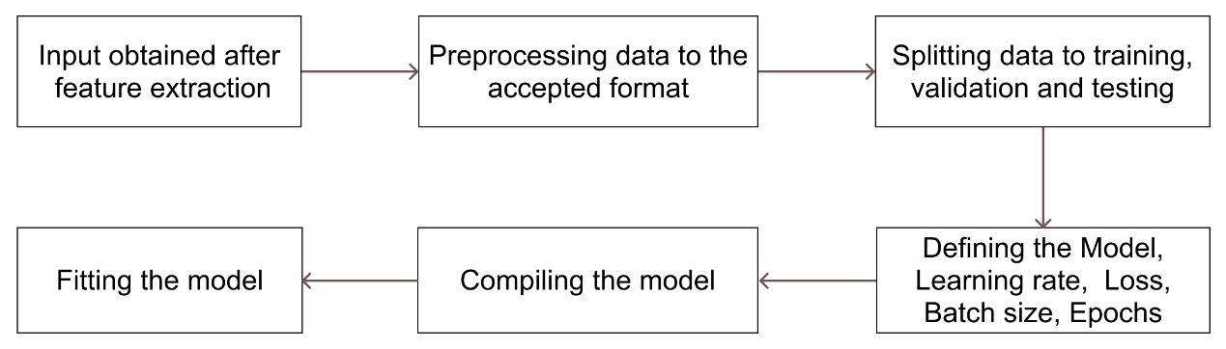
Methodology Cont..
Fig: Training Block Diagram

Slide 11
Methodology: Working Principle
Support Vector Machine (SVM)
SVM for shots classification
Plots the data items in space and finds hyperplane
Hyperplane divides the space into six parts in our case
Hyperplane with maximum marginal distance is optimal
Closer data points to hyperplane are support vectors
Only support vectors contribute to the orientation of hyperplane
Linearly separate non-linear data using SVM kernels

Slide 12
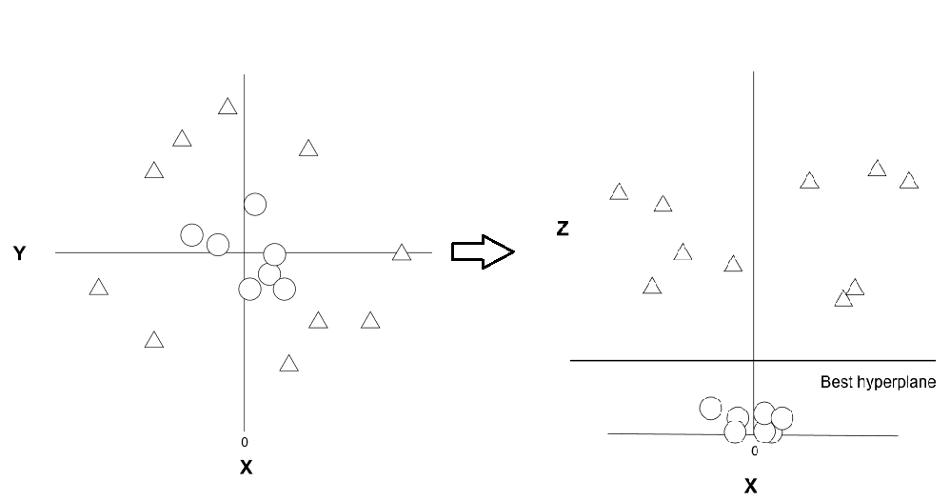
Methodology: Working Principle Cont..
Support Vector Machine (SVM)
Fig: Conversion to Higher Dimension

Slide 13
Methodology: Working Principle Cont..
EfficientDet
Published in 2020 by Google Brain
EfficientDet for object detection i.e bat
Accurate and light model
EfficientNet as backbone
Performs scaling on depth, width and resolution
BiFPN as feature and shared class/box prediction network
Scaling of backbone, feature and detection network

Slide 14
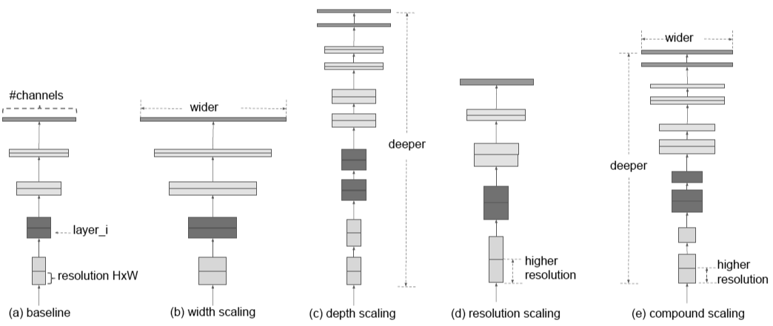
Methodology: Working Principle Cont..
EfficientDet
Fig: Different Scaling Methods [1]

Slide 15
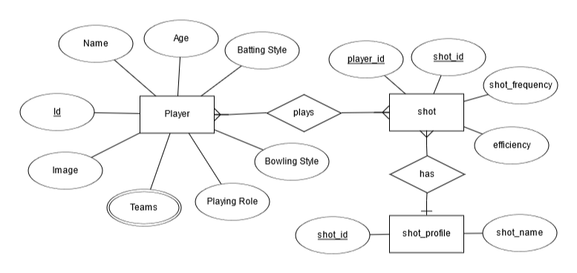
Methodology Cont..
Fig: ER Diagram

Slide 16
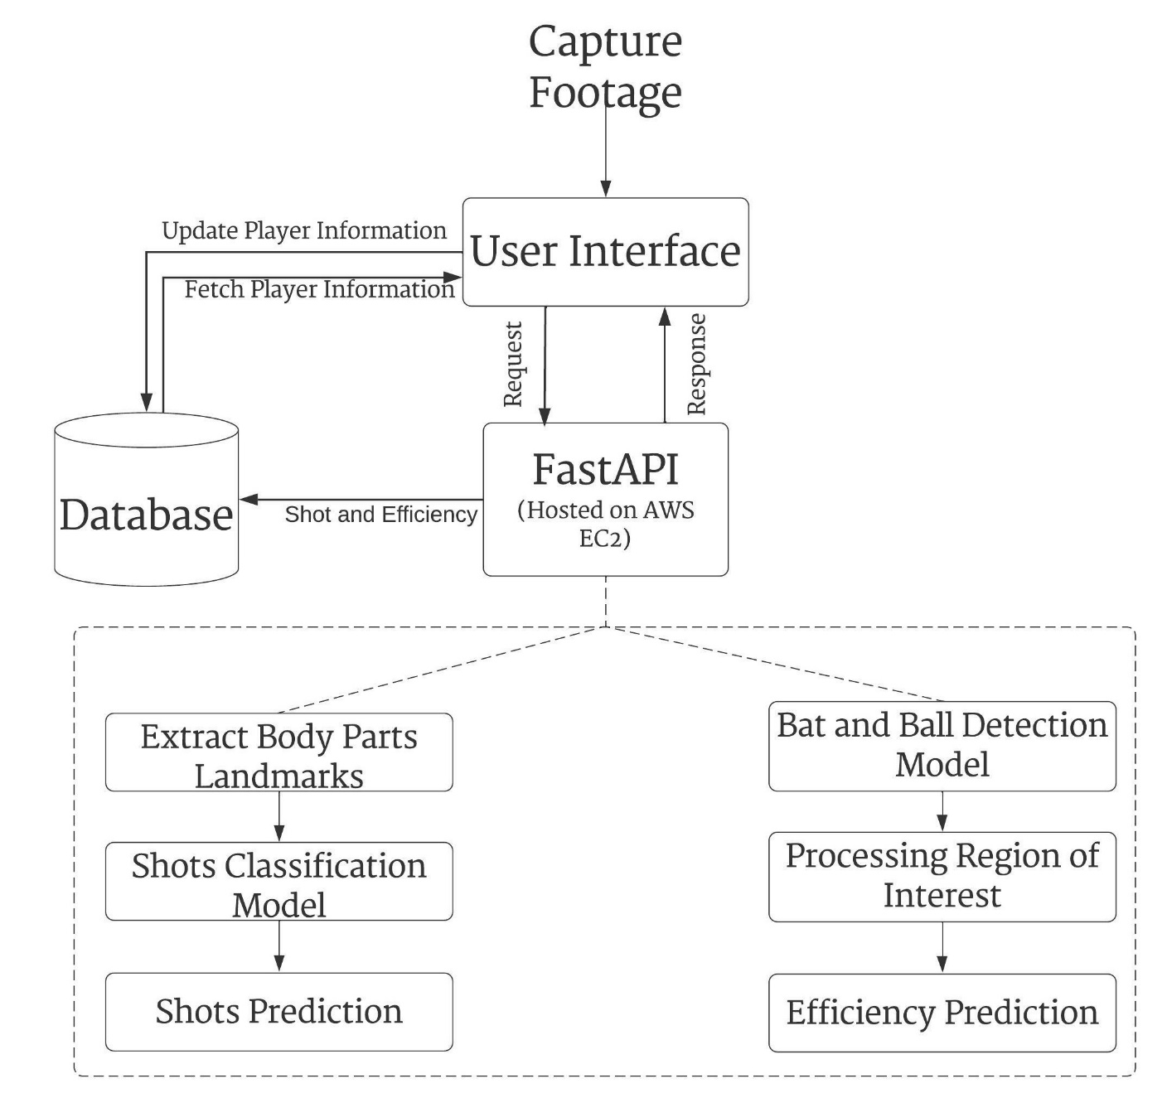
Methodology Cont...
Fig: System Methodology

Slide 17
Methodology Cont..
Software Requirements
Google Colab
Python
NumPy
Scikit-learn
TensorFlow
Mediapipe
OpenCV
Matplotlib
SQL
Dart
Flutter
FastAPI
AWS EC2

Slide 18
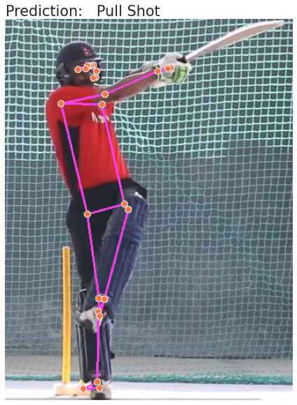
Results: Shot Classification
Fig: Predicted Pull Shot [2]

Slide 19
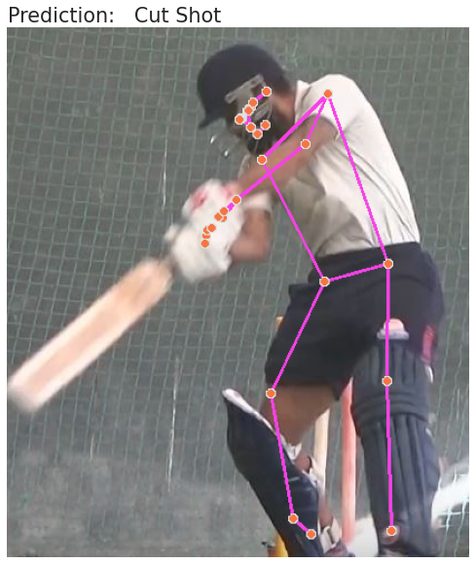
Results: Shot Classification Cont..
Fig: Predicted Cut Shot [3]

Slide 20
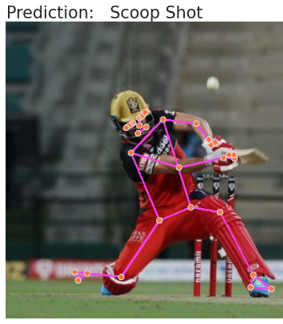
Results: Shot Classification Cont..
Fig: Predicted Scoop Shot [4]

Slide 21
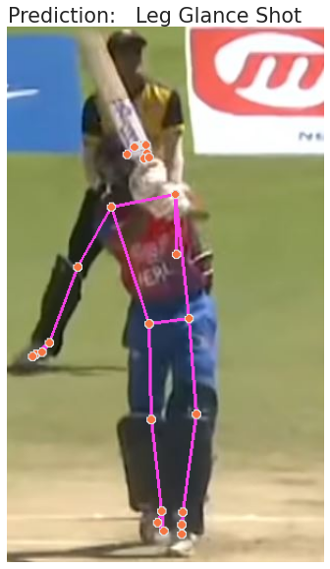
Results: Shot Classification Cont..
Fig: Predicted Leg Glance Shot [5]

Slide 22
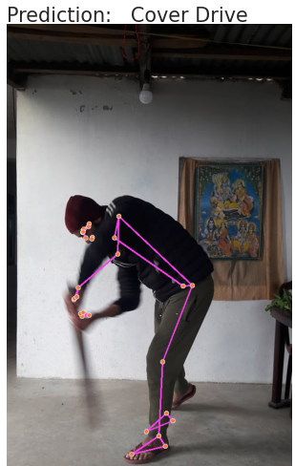
Results: Shot Classification Cont..
Fig: Predicted Cover Drive

Slide 23
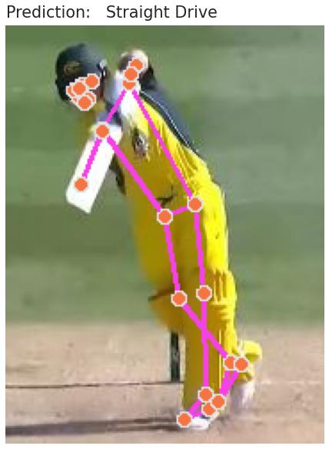
Results: Shot Classification Cont..
Fig: Predicted Straight Drive [6]

Slide 24
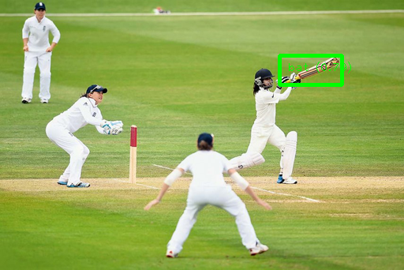
Results: Bat Detection Cont..
Fig: Bat Detection Far Angle [7]

Slide 25
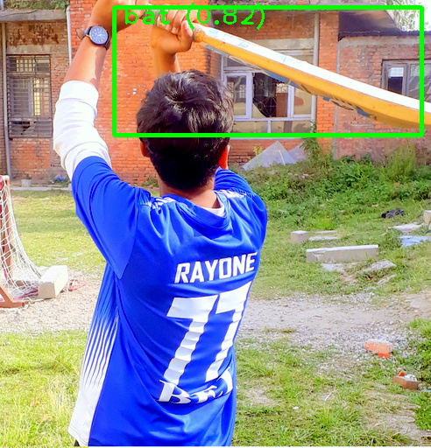
Results: Bat Detection Cont..
Fig: Bat Detection Close Angle

Slide 26
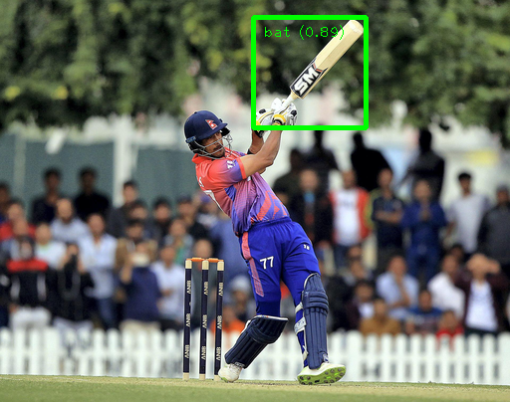
Results: Bat Detection Cont..
Fig: Bat Detection on Focused Image [8]

Slide 27
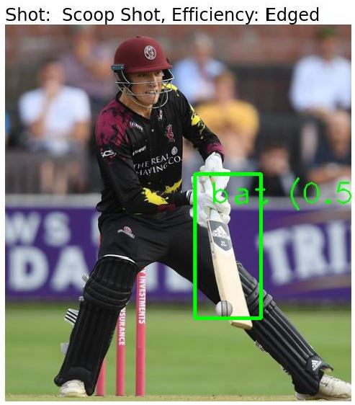
Results: Shots and Efficiency Prediction
Fig: Shot and Efficiency Prediction [9]

Slide 28
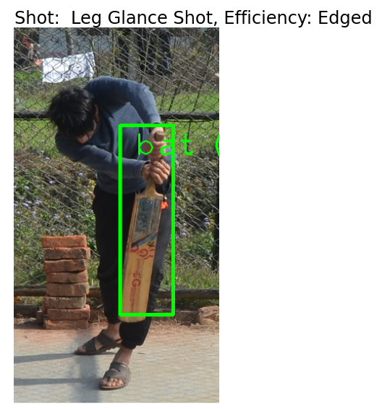
Results: Shots and Efficiency Prediction
Fig: Shot and Efficiency Prediction (Wrong Result)

Slide 29
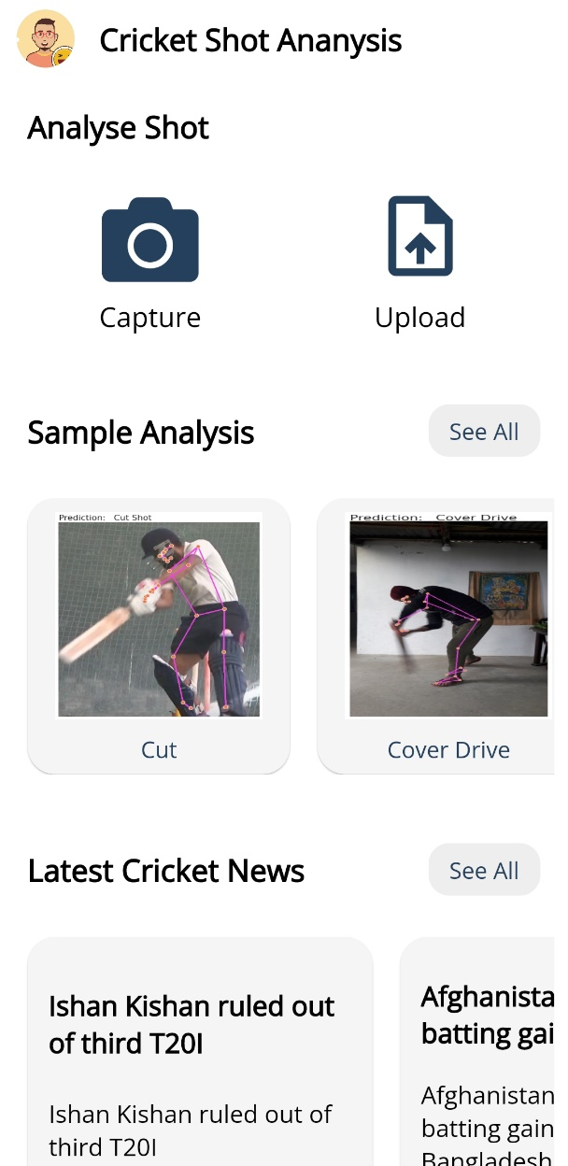
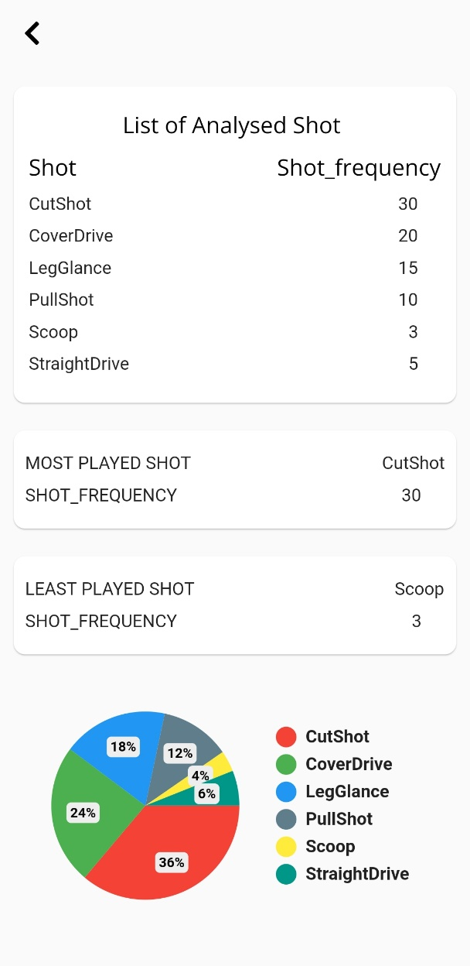
Results Cont..
Fig: Mobile App UI

Slide 30
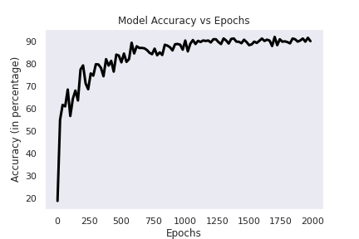
Analysis of Results
Fig: Model Accuracy vs Epochs

Slide 31
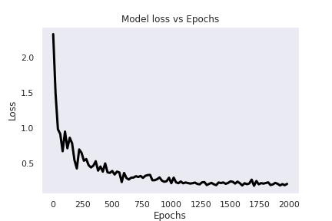
Analysis of Results Cont..
Fig: Model Loss vs Epochs

Slide 32
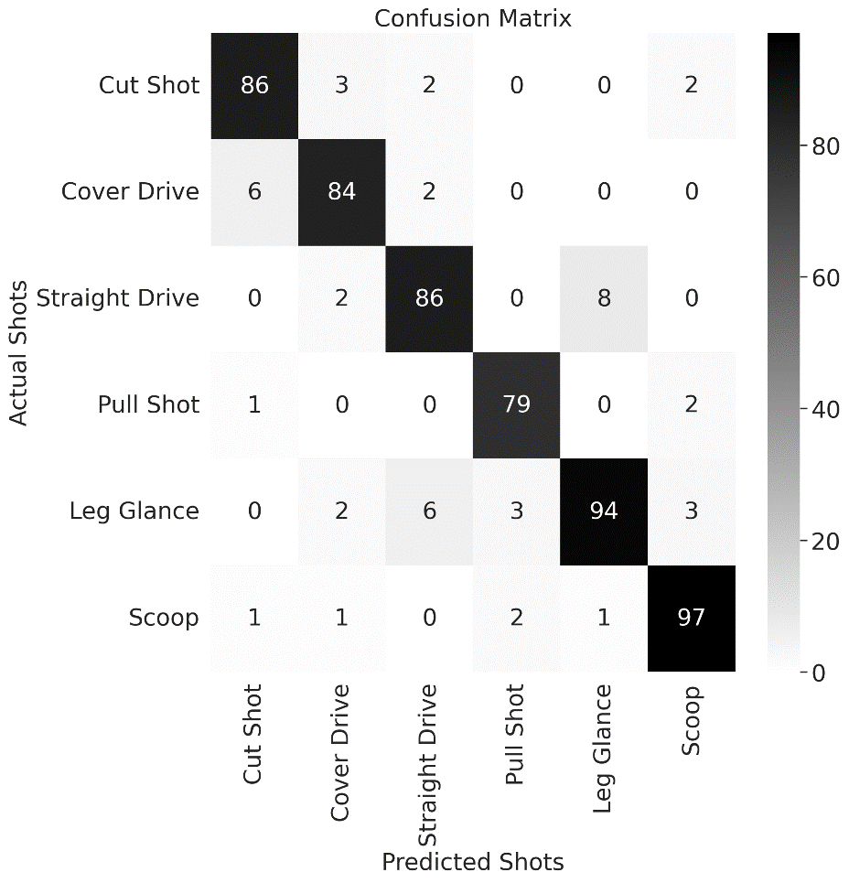
Analysis of Results Cont..
Fig: Confusion Matrix

Slide 33
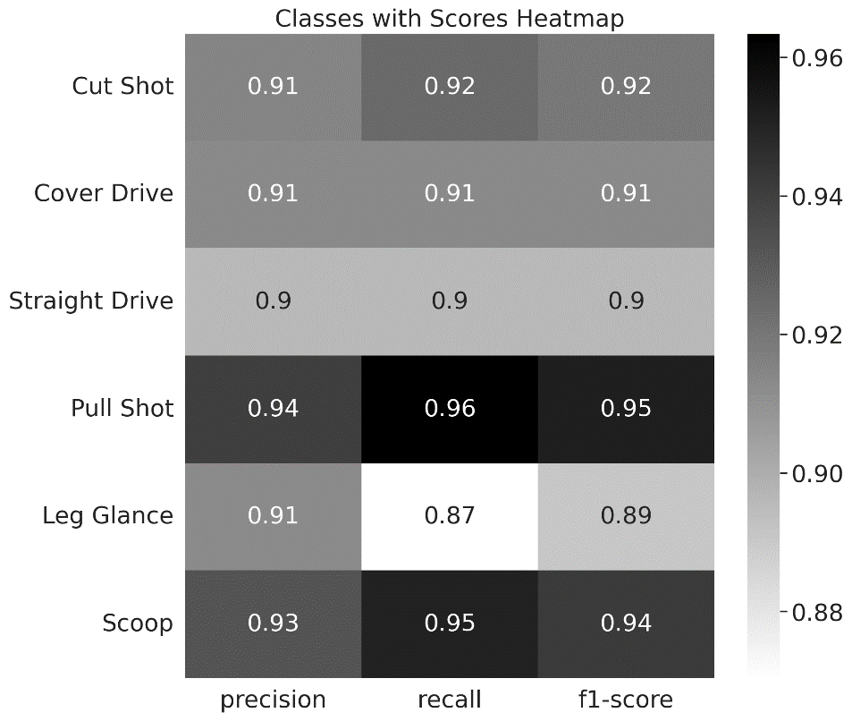
Analysis of Results Cont..
Fig: Classes with Scores Heatmap

Slide 34
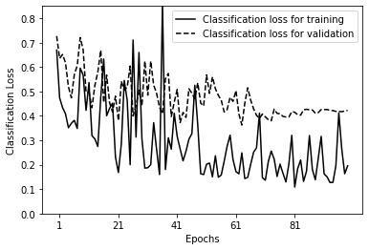
Analysis of Results Cont..
Fig: Classification loss for training and validation

Slide 35
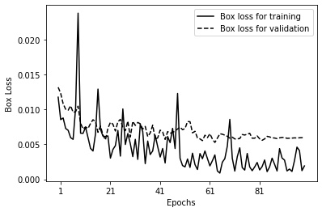
Analysis of Results Cont..
Fig: Box loss for training and validation

Slide 36
Future Enhancements
Enhancement of machine learning models
Dataset collection from multiple angles, multiple categories, varying backgrounds
Addition of features like ball tracking, wagon wheel, speedometer
Complete cricket software package development

Slide 37
Conclusion
Classification of shots into six categories using SVM model
Efficiency determined using EfficientDet model
UI developed for easy use of this application to users

Slide 38
References
[1] M. Tan, R. Pang and Q. Le, "EfficientDet: Scalable and Efficient Object Detection", 2020 IEEE/CVF Conference on Computer Vision and Pattern Recognition (CVPR), 2020. Available: 10.1109/cvpr42600.2020.01079 [Accessed 21 January 2022].
[2] HamroKhelKud.com, 2021. Pull Shot. [image] Available at: <https://hamrokhelkud.com/> [Accessed 26 January 2022].
[3] CricketingNepal.com, 2021. Cut Shot Shot. [image] Available at: <https://cricketingnepal.com/> [Accessed 22 January 2022].
[4] CricFit, 2021. Scoop Shot. [image] Available at: <https://cricfit.com/> [Accessed 10 January 2022].

Slide 39
References
[5] Cricket Association of Nepal, 2021. Leg Glance Shot. [image] Available at: <https://cricketnepal.org.np/> [Accessed 21 January 2022].
[6] Cricket Australia, 2021. Straight Drive Shot. [image] Available at: <https://www.cricketaustralia.com.au/> [Accessed 20 January 2022].
[7] GameOn Esports, 2020. Test Cricket. [image] Available at: < https://gameon-esports.com/live-each-moment-from-the-complement-cricket-news.html/> [Accessed 29 January 2022].

Slide 40
References
[8] The National, 2019. Paras Khadka at ICC Global Academy in Dubai. [image] Available at: <https://www.thenationalnews.com/sport/cricket/paras-khadka-becomes-first-nepal-batsman-to-score-t20-international-century-1.916481/>[Accessed 30 January 2022].
[9] "Tom Banton Masterclass: The Scoop Shot - Somerset County Cricket Club", Somerset County Cricket Club, 2022. [Online]. Available: https://www.somersetcountycc.co.uk/news/first-xi/tom-banton-masterclass-the-scoop-shot/. [Accessed: 25- Feb- 2022]

